Slide 1
We need to change the education system,
but we can't force everyone at once.

Slide 2
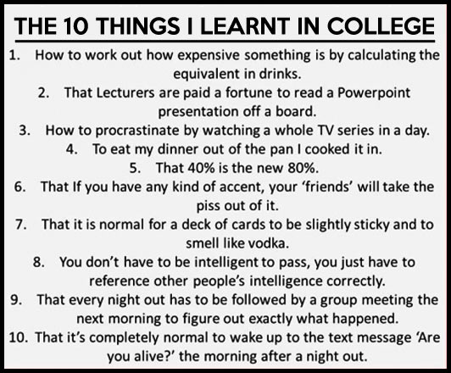

Slide 3
What are the problems?

Slide 4
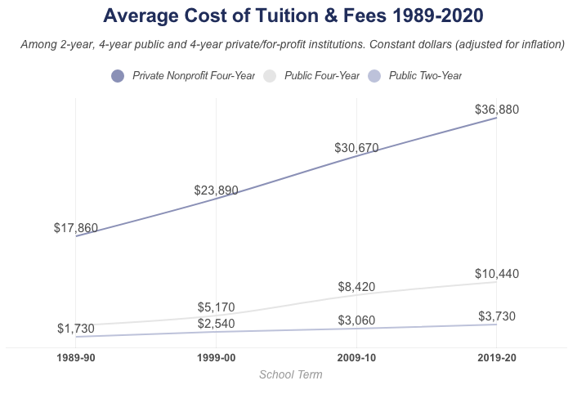
Too expensive

Slide 5
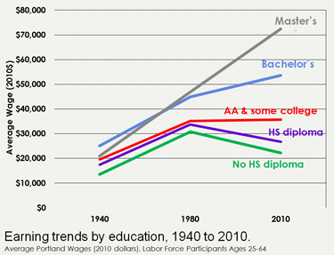
Doesn’t help with your career

Slide 6
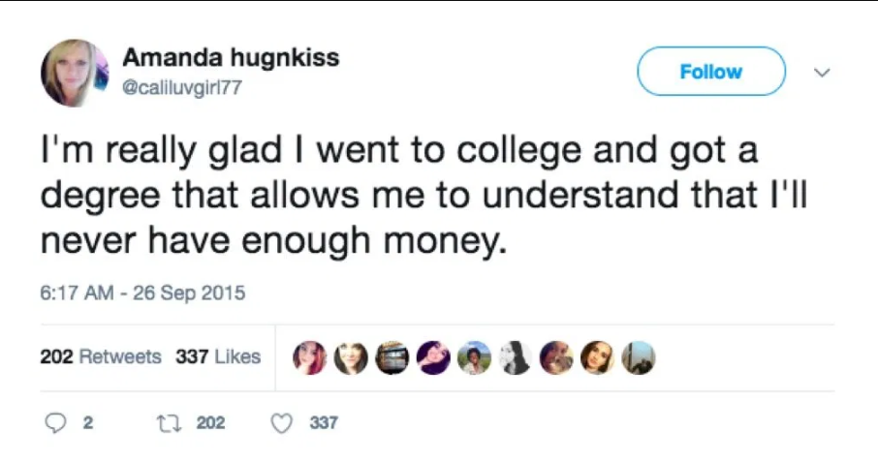
No real-world experience is learned.

Slide 7
WHAT CAN we CHANGE TO HELP SOLVE THIS PROBLEM?

Slide 8
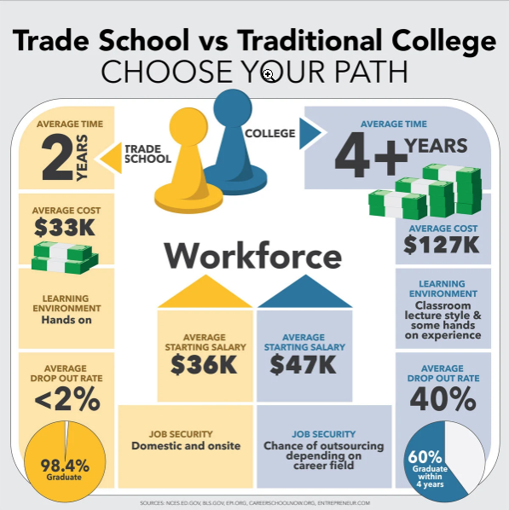
OPTION 1 – More trade school degrees
2 years
Lower average cost
In person, hands on learning
Lower dropout rate

Slide 9
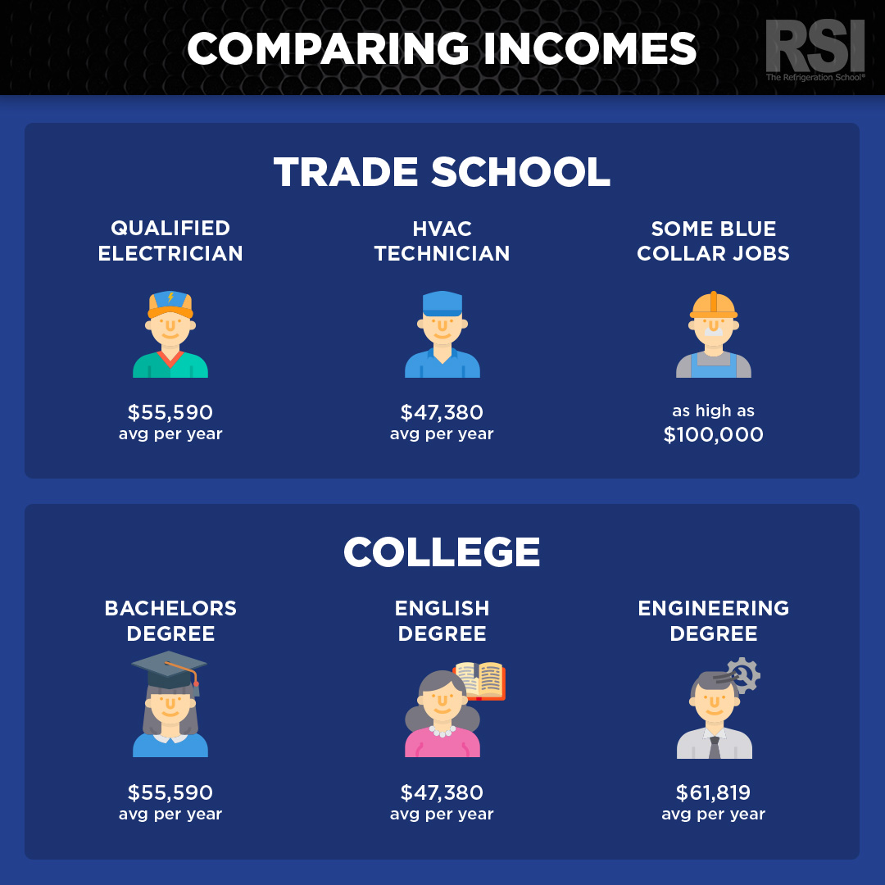

Slide 10
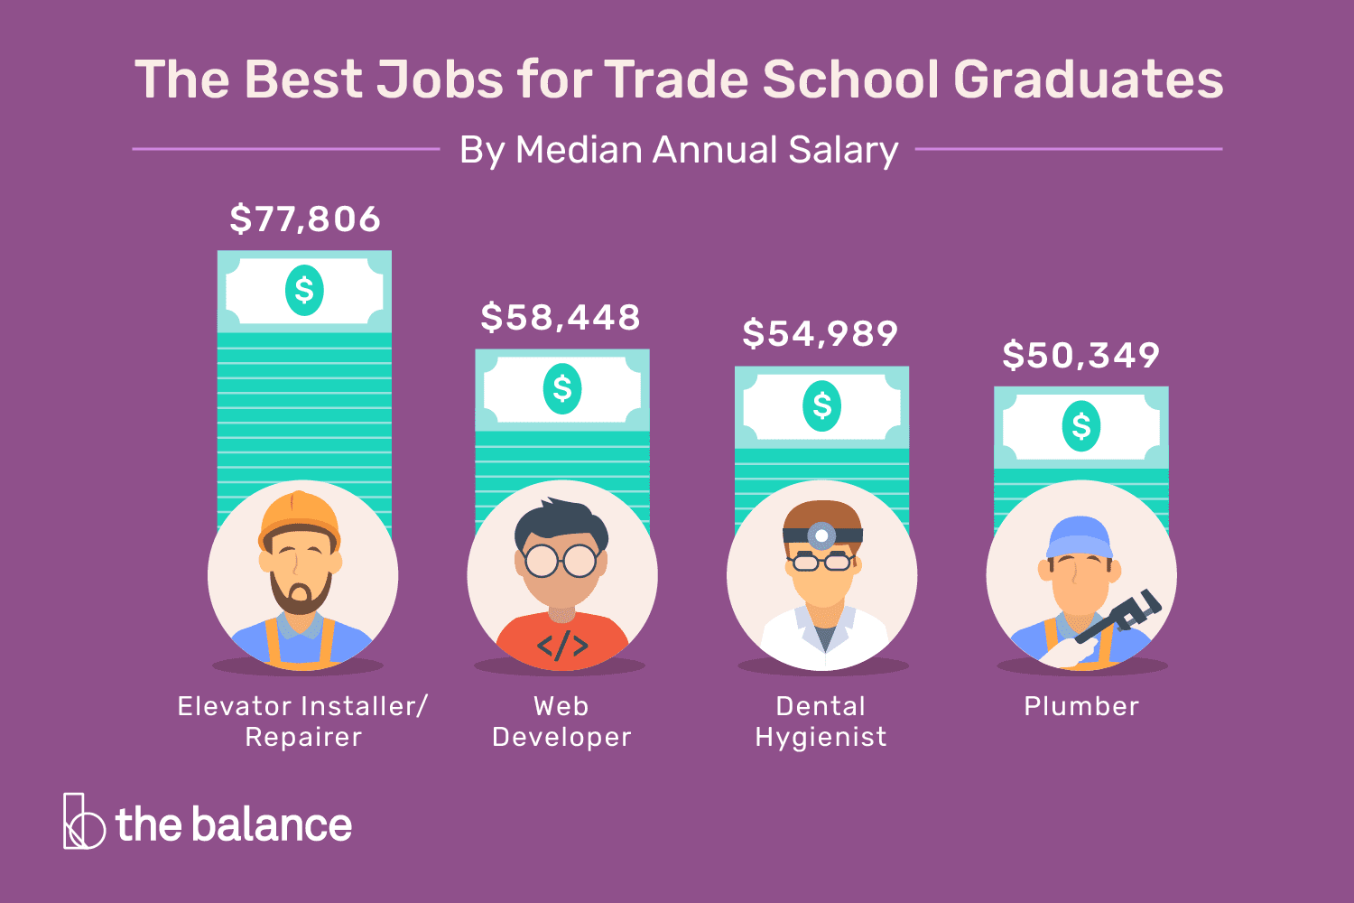

Slide 11

OPTION 2 – Format change
First year no official degree
1 year of required classes about how to “life” (economics, civics, mental health, food & nutrition, etc.)
After first year you declare degree path.
Allows for students to learn more about the world.
4 years in total

Slide 12

OPTION 3 – Update degree’s
Change degree requirements based on current career climate.
Possible add of other classes that are needed.
Require real world experience to finish degree.
Eliminate degrees that have low income/success rates.

Slide 13
HOW WILL THIS SOLUTION IMPROVE THE EDUCATION SYSTEM?

Slide 14
WHAT NEEDS TO HAPPEN?

